Slide 1
VISTA
CAPSTONE PROJECT DEFENSE · FPT UNIVERSITY · FA2AI63
A Vision-Language-Action System for Tabletop Manipulation with Robot Arms
Nguyễn Gia Phát · Nguyễn Minh Đức · Nguyễn Lê Anh Quân · Nguyễn Duy Sơn
Supervisor: Mr. Lưu Giang Nam, Ph.D · Ho Chi Minh City, 12/2026
Notes:
Opening. Introduce team, supervisor and the one-sentence question: can a better lightweight VLM backbone improve SmolVLA without losing efficiency?

Slide 2
Roadmap of the defense
AGENDA
I
Project Introduction
II
Project Management
III
Existing Systems
IV
Methodology
V
System Design
VI
Results & Discussion
Q&A
VII
Conclusion
Discussion
VISTA · Capstone Defense
Source: Report ToC
Notes:
About 60 minutes: Sections I–III about 20 min, IV about 15 min, V–VII results placeholders about 10 min, Q&A remainder. Sections V–VII are marked TBD until experiments finish.

Slide 3
Project and team at a glance
I.1.1 PROJECT INFORMATION
Project
Code · Group
Supervisor
VISTA: VLA system for tabletop manipulation with robot arms
FA2AI63 · GFA26AI04
Mr. Giang-Nam Luu, Ph.D
Nguyễn Gia Phát
Nguyễn Minh Đức
Nguyễn Lê Anh Quân
Nguyễn Duy Sơn
Project Manager
AI Engineer
Data Engineer
AI Engineer
VISTA · Capstone Defense
Source: Report §I.1.1, Table 1
Notes:
Four-member team. Roles detailed in Section II.1.1.

Slide 4
Can a better backbone improve SmolVLA?
I.1.2 PROJECT OVERVIEW
Can alternative lightweight VLMs replace SmolVLA’s backbone, improve manipulation, and keep its efficiency?
Swap backbone
Compare against
Two real tasks
SmolVLM-2 → LFM2.5-VL-0.45B or FastVLM-0.5B
Original SmolVLA and ACT baseline
Desk Stationery Decluttering (pilot) · Halogen Lampshade Tray Packaging
Platform: SO-ARM101 + LeRobot · Metrics: task success and computational efficiency
VISTA · Capstone Defense
Source: Report §I.1.2
Notes:
Hypothesis: an appropriately selected backbone boosts manipulation without disproportionate overhead. The report order: planning, existing systems, methodology, design, results, conclusion.

Slide 5
Three final deliverables
I.1.2 PROJECT OVERVIEW
1 · Capstone report
2 · Demo videos
3 · Control app (prototype)
Problem, solution, training, evaluation, analysis, recommendations. Every claim checked against data or a citation.
Two videos of SO-ARM101 performing the 2 tasks on real hardware.
Run and switch policies, live camera stream, 3D arm-pose view.
VISTA · Capstone Defense
Source: Report §I.1.2
Notes:
The app lets users run a chosen policy, switch between baseline and variants, and watch the live camera with a 3D visualization of the arm pose.

Slide 6
From costly arms to compact VLAs
I.2 PROJECT BACKGROUND
Before 2023
ALOHA + ACT
LeRobot + SO-ARM101
SmolVLA (Jun 2025)
Now
Large, costly hardware
Low-cost fine manipulation
Compact VLA on SmolVLM
New lightweight VLMs to test
Open stack, cheap arm
SmolVLM-2 is pretrained mainly on document reading and OCR, so object localization is a hypothesized weak point for manipulation.
VISTA · Capstone Defense
Source: Report §I.2 [26],[34],[6],[14]
Notes:
Trade-off in SmolVLA: efficiency vs capability. Its authors chose the most compact VLM available in 2025. Since then, newer lightweight VLMs appeared; we selected LFM2.5-VL-0.45B and FastVLM-0.5B.

Slide 7
Six objectives, O6 is the highest level
I.3 PROJECT OBJECTIVE
O1
Integrate 2 backbones into SmolVLA
O2
Train ACT, SmolVLA and 2 variants
O3
Evaluate success rate and efficiency
O4
Demo on SO-ARM101 at partner factory
O5
Reusable backbone-integration strategy
O6
Assess lightweight-VLA potential
VISTA · Capstone Defense
Source: Report §I.3
Notes:
Primary objective: investigate whether replacing the SmolVLA backbone improves manipulation while maintaining or improving efficiency. Metrics: training loss, duration, step time, success rate, latency, memory, parameter count. O4 targets a partner factory producing halogen light bulbs.

Slide 8
Two limitations of SmolVLA
I.4 PROBLEM STATEMENT
1 · Backbone not made for robotics
2 · No room to grow
Off-the-shelf SmolVLM-2, pretrained mainly on documents and OCR. Only 64 visual tokens per frame, no image tiling.
Already a tiny VLM using a subset of layers. Scaling up would cost the efficiency that defines it.
Challenges:
backbone selection · layer selection · integration (adapter) · uncertain outcome
VISTA · Capstone Defense
Source: Report §I.4 [26]
Notes:
SmolVLA is about 0.45B parameters, trainable on one GPU. Limitations are raised by its own authors. Candidates: FastVLM, LFM2-VL, Qwen3.5-0.8B. A new backbone may not remove either limitation, so conclusions rest on evaluation.

Slide 9
Why the project matters
I.5 SIGNIFICANCE
Scientific
Practical
Community
Empirical answer to an open question raised by SmolVLA’s authors: does a grounding-oriented backbone help at comparable scale?
Low-cost SO-ARM101 + compact policy as a cheaper option for small and medium factories (simple repetitive sorting).
A documented swap strategy: choose backbone, select layers, adapt, train, evaluate. Lowers custom engineering.
VISTA · Capstone Defense
Source: Report §I.5
Notes:
Whatever the outcome, results are informative. Researchers with stronger hardware can try larger backbones; limited-resource teams can test small ones.

Slide 10
What the project will and will not cover
I.6 SCOPE
In scope
Backbone replacement (few lightweight VLMs)
Swapping framework: layers, dims, training
300 demos per task, self-collected
Same data and settings for all variants
Success rate + params, memory, latency
Analysis of backbone properties
Out of scope
New VLA architecture or action-expert redesign
Large-scale pretraining or training from scratch
Cross-embodiment, long-horizon, other tasks
Backbones above 1B parameters
Production deployment, safety certification
Proving the 2 limitations are eliminated
VISTA · Capstone Defense
Source: Report §I.6
Notes:
Candidates drawn from Qwen3.5-0.8B, FastVLM and LFM2/LFM2.5-VL; final list depends on integration effort and compute.

Slide 11
Five known limitations
I.6 LIMITATIONS
Small candidate set
Limited data and trials
Single robot
A better backbone may exist untested.
Far less than SmolVLA pretraining data.
Low-cost arm, limited payload and precision.
Compute limits
Fast-changing field
Tuning and training length bounded by GPU quota.
Candidate list fixed at a defined point.
VISTA · Capstone Defense
Source: Report §I.6
Notes:
Results indicate feasibility for light sorting tasks only.

Slide 12
Four roles, twice-weekly meetings
II.1.1 TEAM STRUCTURE
Member | Role | Responsibilities
Nguyễn Gia Phát | Project Manager | Plan, milestones, supervisor and factory contact, final report
Nguyễn Minh Đức | AI Engineer | Trains policies, backbone-swap code, control app
Nguyễn Lê Anh Quân | AI Engineer | Code review, tuning, result logs, metric analysis, app tests
Nguyễn Duy Sơn | Data Engineer | Data collection and cleaning, test setup, real-robot trials, videos
Tools: Zalo, Gmail, Discord · In-person meetings Wednesday and Sunday · daily same-day reports
VISTA · Capstone Defense
Source: Report §II.1.1, Table 1
Notes:
Every member writes the report sections for their own work; Phát compiles and checks.

Slide 13
Who talks to whom, how often
II.1.2 COMMUNICATION
Who | Frequency | Purpose
PM and team | Daily | Check tasks, spot problems early
Whole team | Wed + Sun | Review deliverables and milestones
AI / Data Engineers | Daily | Worklog, daily report, dataset-ready notices
Factory partner | Weekly | Requests, test schedule, site safety, video permission
Supervisor | Weekly | Advice, progress, scope decisions
VISTA · Capstone Defense
Source: Report §II.1.2, Table 2
Notes:
Factory requests follow the change-control rule in Section II.2.5.

Slide 14
Ten work packages, 15-Sep to 30-Nov
II.2.1 WBS
1 · Project mgmt
Phát
2 · Research
Phát
3 · Methodology
Phát
4 · Data collection
Sơn
5 · Integration
Đức
6 · Training
Quân
7 · Evaluation
Quân
8 · Control app
Đức
9 · Demo
Sơn
10 · Reporting
Phát
VISTA · Capstone Defense
Source: Report §II.2.1 WBS
Notes:
Gantt derived from WBS start and end dates. Each package has an owner and support member; milestones on the next slide.

Slide 15
Six milestones gate the plan
II.2.1 WBS
12-Oct
27-Oct
30-Oct
20-Nov
TBC
30-Nov
Protocol freeze
Review 2
Dataset v1.0 frozen
Training complete
Review 3
Final submission
Review 3 date is a placeholder until confirmed. Changes after a freeze require explicit versioning (Section II.2.5).
VISTA · Capstone Defense
Source: Report §II.2.1, II.2.5
Notes:
Freezes protect comparability: protocol before final trials, dataset before any final training.

Slide 16
Three major risks and responses
II.2.2 RISK MANAGEMENT
Risk | Cause | Prevention | Contingency
Training delay / lost results | GPU quota, session loss | Kaggle GPUs, parallel runs, regular checkpoints to persistent storage | Prioritize baselines and primary conditions
SO-ARM101 failure | Wear, damage, shipping delay | Pre-checks, dataset backups, second arm | Switch to backup; do software and data tasks
Member unavailable | Illness, unforeseen | Shared repo, backup owner per critical task | PM reassigns and reschedules
Risks monitored throughout; materialized risks trigger a documented plan update.
VISTA · Capstone Defense
Source: Report §II.2.2
Notes:
Likelihood and impact assessed per risk.

Slide 17
TBD — to be updated after experiments
II.2.3 QUALITY MANAGEMENT
[Quality measures]
[Testing and validation]
[Quality gates G1–G3]
Report section is empty. WBS 10.12 mentions a claim ledger with quality gates G1–G3 (writer and verifier must differ).
VISTA · Capstone Defense
Source: Report §II.2.3, WBS 10.12
Notes:
Fill after confirming the quality plan.

Slide 18
12,504,000 VND, self-funded
II.2.4 BUDGET
Servos (2 sets of 12)
9,385
Control electronics
1,114
Cameras
881
Accessories
667
3D-print material
352
Shipping
105
Values in thousand VND, Jul–Oct 2026 · about 3,126,000 VND per member. Partner lab sponsors 3D printer and PETG. Training uses free Kaggle GPU quota.
VISTA · Capstone Defense
Source: Report §II.2.4
Notes:
The second servo set supports the backup arm of Risk 2.

Slide 19
Five-step change-control process
II.2.5 CHANGE MANAGEMENT
1
2
3
4
5
Change request registered with Change ID
Impact assessment: scope, schedule, cost, quality, risk
Approval: Approved, Rejected or Deferred
Baseline update within one working day
Implementation and closure with evidence
Tracked in WBS 1.4 · Google Drive, ClickUp, Kaggle, Discord · reviewed Wed and Sun
VISTA · Capstone Defense
Source: Report §II.2.5
Notes:
Process preserves experimental integrity by keeping changes to tasks, datasets, backbone and protocol traceable.

Slide 20
Three levels of approval authority
II.2.5 CHANGE MANAGEMENT
Level | Examples | Approval
Minor | Reschedule internal work; reallocate data processing | PM
Medium | Demos 300 → 250; training steps or batch size; extra spare parts | PM + supervisor
Major | Replace a backbone; change second task; revise evaluation after freeze | PM + supervisor; factory partner if commitments affected
VISTA · Capstone Defense
Source: Report §II.2.5, Table 5
Notes:
Approval structure is a prospective governance rule, not retrospective approval.

Slide 21
Closure needs more than a finished report
II.2.6 CLOSURE
Deliverable acceptance
Sign-offs
Verification
Report, 2 demo videos, control app, integration guide, claim ledger, risk and change logs, budget records.
PM confirms completeness; supervisor confirms academic and technical acceptance; factory confirms on-site tests.
WBS 10.12 (22–28 Nov): a different person verifies than the one who wrote it.
VISTA · Capstone Defense
Source: Report §II.2.6
Notes:
Archiving: code on GitHub with release tag; Google Drive keeps dataset v1.0 with hashes, checkpoints, logs, videos.

Slide 22
Success judged against O1–O6
II.2.6 EVALUATION
Objective | Evidence | Verdict
O1 Integrate backbones | Code, interface checks, configs | TBD
O2 Train 4 models | Kaggle logs, checkpoints | TBD
O3 Evaluate | Success rate, latency, memory, params | TBD
O4 Real-world demo | Two videos, app tests | TBD
O5 Integration strategy | Guide + independent walkthrough | TBD
O6 Lightweight-VLA potential | Synthesis of O1–O5 | TBD
Technical success: at least one variant improves or is non-inferior in success rate within efficiency limits. Margin set before outcome inspection.
VISTA · Capstone Defense
Source: Report §II.2.6
Notes:
Verdicts remain blank until evidence review. Negative or inconclusive findings will be reported accurately.

Slide 23
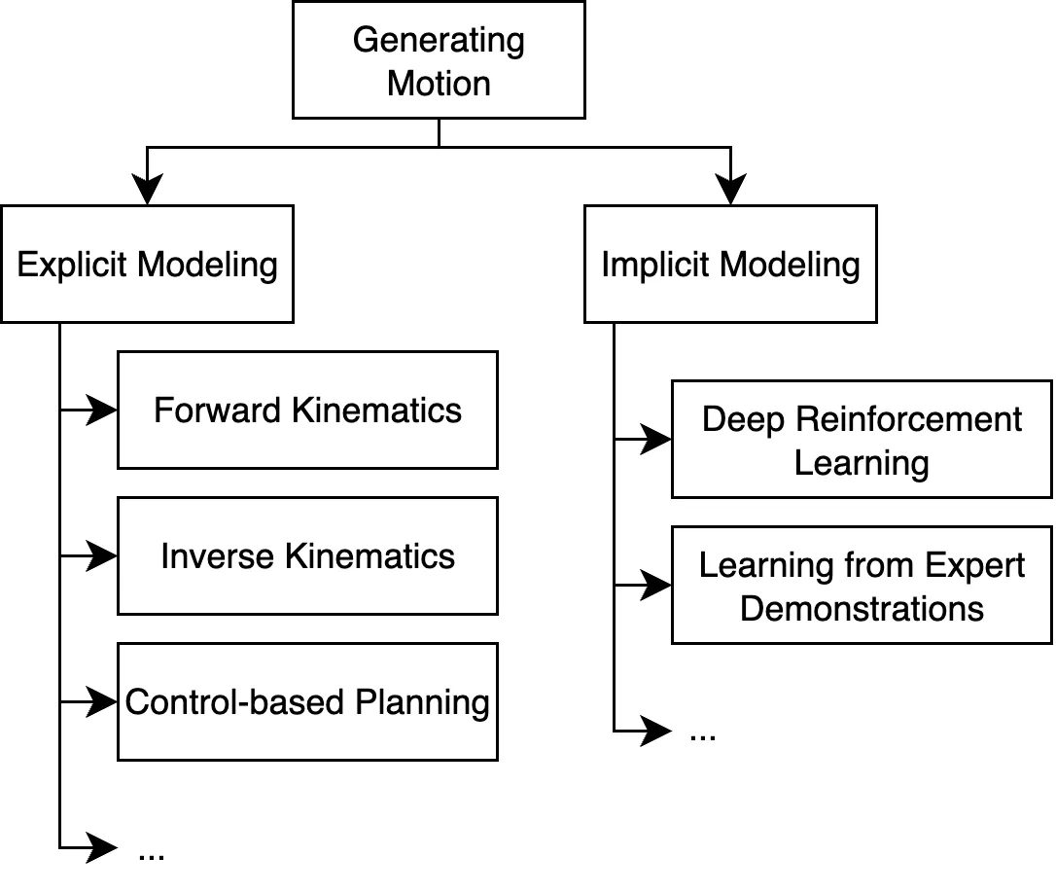
Two families of motion generation
III.1 OVERVIEW OF THE FIELD
Explicit
Built on dynamics: rigid links and contact models.
Implicit
Motion as a pattern learned from sensorimotor data. Robot learning belongs here.
VISTA · Capstone Defense
Source: Report Fig. 1
Notes:
Figure 1 of the report. Learned visuomotor policies remove interfaces between perception, planning and control.

Slide 24
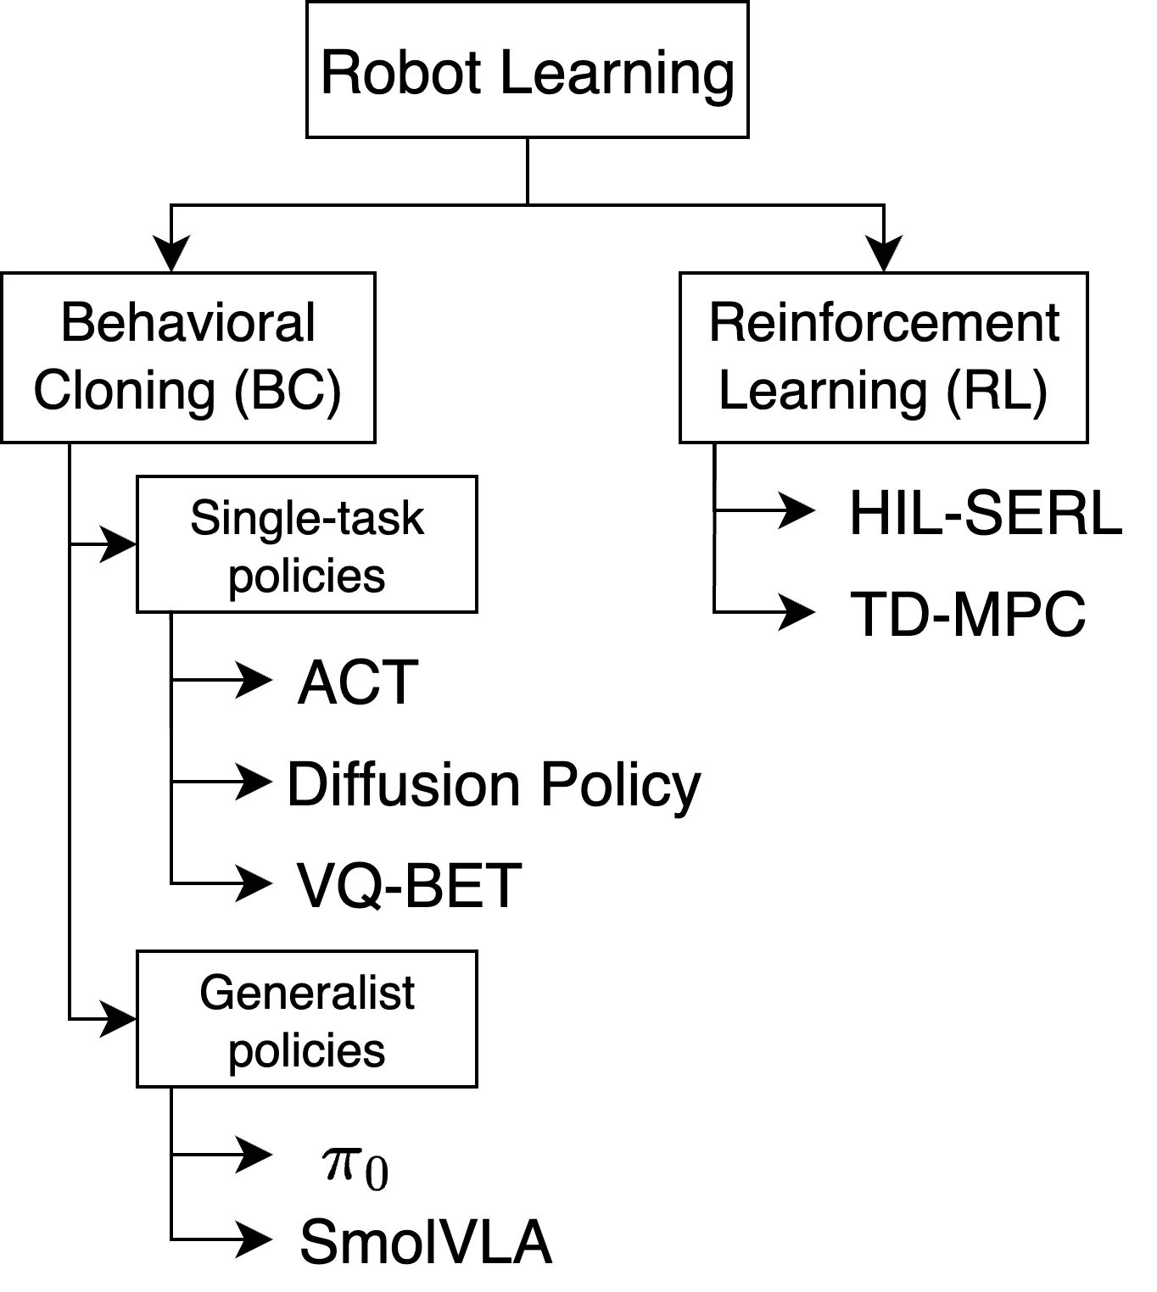
This project sits in Behavioral Cloning
III.1 OVERVIEW OF THE FIELD
Why not RL?
On real hardware exploration is costly and unsafe, rewards are brittle, resets are needed.
BC: two branches
Single-task (ACT) and generalist (SmolVLA). Both reproduce demonstrations.
VISTA · Capstone Defense
Source: Report Fig. 2
Notes:
Application studied: tabletop manipulation with a robot arm.

Slide 25
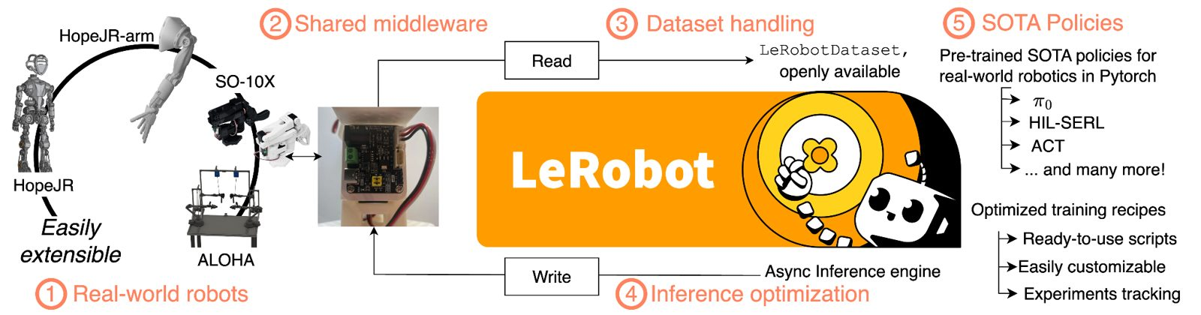
From specialist policies to open generalists
III.2 HISTORICAL CONTEXT
1989
2023
2021–23
2023–25
ALVINN: BC as supervised learning
ALOHA + ACT: low-cost fine manipulation
BC-Z, RT-1, RT-2: language-conditioned
Open X-Embodiment, DROID, OpenVLA, π0, SmolVLA
LeRobot: open-source end-to-end robot learning stack. SO-ARM101 descends from this movement.
VISTA · Capstone Defense
Source: Report §III.2, Fig. 3
Notes:
Order of the first two items follows dates implied in the report: Pomerleau 1988/89 and ALOHA/ACT 2023. Earlier BC data was small and task-bound; negative transfer across embodiments.

Slide 26
From ACT to open VLAs
III.3 KEY STUDIES
1
2
3
4
5
ACT: action chunks + CVAE, task-specific, no language
BC-Z / RT-1: language-conditioned, large demonstrations
RT-2: VLA paradigm, VLM outputs actions as tokens
Open X-Embodiment (~1.4M trajectories), DROID
OpenVLA: open weights, Llama 2 7B + vision encoder
ACT is our conventional imitation baseline; the VLM backbone becomes a core VLA component from RT-2 onward.
VISTA · Capstone Defense
Source: Report §III.3.1–3.3
Notes:
OpenVLA opens VLA research but still demands heavy compute.

Slide 27
SmolVLA and its SmolVLM2 backbone
III.3 KEY STUDIES
SmolVLA
SmolVLM2 backbone
Pretrained SmolVLM + action expert with flow matching. Visual token reduction, selective layer execution, interleaved attention, asynchronous inference. Works with SO-100/101.
Compact VLM for image description, VQA and documents. Training mostly document reading and OCR, so weak for images.
Open question: can a better compact VLM improve representations for control at similar efficiency?
VISTA · Capstone Defense
Source: Report §III.3.4–3.5
Notes:
Project does not build a new VLA; it tests backbone replacement.

Slide 28
Three developments make this feasible
III.4 TECHNOLOGICAL ADVANCES
Open low-cost hardware
LeRobot ecosystem
Compact VLMs
Single arm about €225 vs about €21k for bimanual ALOHA. Leader-follower pair for demo and deployment.
One dataset format; over 16k datasets from 2.2k contributors (Sep 2025). ACT, Diffusion, π0, SmolVLA included.
FastVLM (hybrid conv-transformer encoder), LFM2-VL 450M. Sub-billion models for edge use.
Caveat: published VLM gains come from QA benchmarks; FastVLM latency measured on Apple silicon. Transfer to our hardware is unproven.
VISTA · Capstone Defense
Source: Report §III.4
Notes:
LeRobot sizes: ACT ~52M, SmolVLA ~450M, π0 3.5B; SmolVLA ~1.75 GB peak GPU memory in fp32 vs π0 ~13 GB. Note the report quotes ~80M for ACT in Section III.5; reconcile before the defense.

Slide 29
ACT vs π0 vs SmolVLA
III.5.1 COMPARISON OF POLICIES
Aspect | ACT | π0 | SmolVLA
Category | Imitation policy | Generalist VLA | Lightweight VLA
Architecture | CVAE + Transformer | VLM + flow-matching expert | VLM + flow-matching expert
Language | Not supported | Supported | Supported
Parameters | ~80M | ~3B | ~450M
Main limit | No language, task-specific | High compute and data | Capacity inherited from VLM
VISTA · Capstone Defense
Source: Report §III.5.1
Notes:
SmolVLA is the intermediate point; its action generation depends on VLM representations, so backbone choice matters.

Slide 30
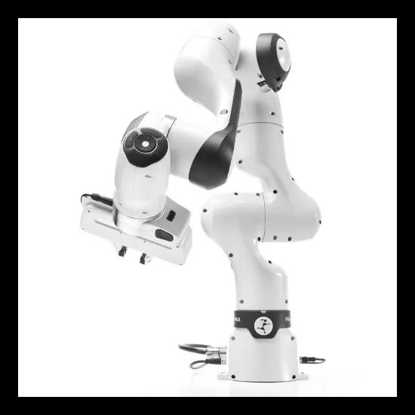
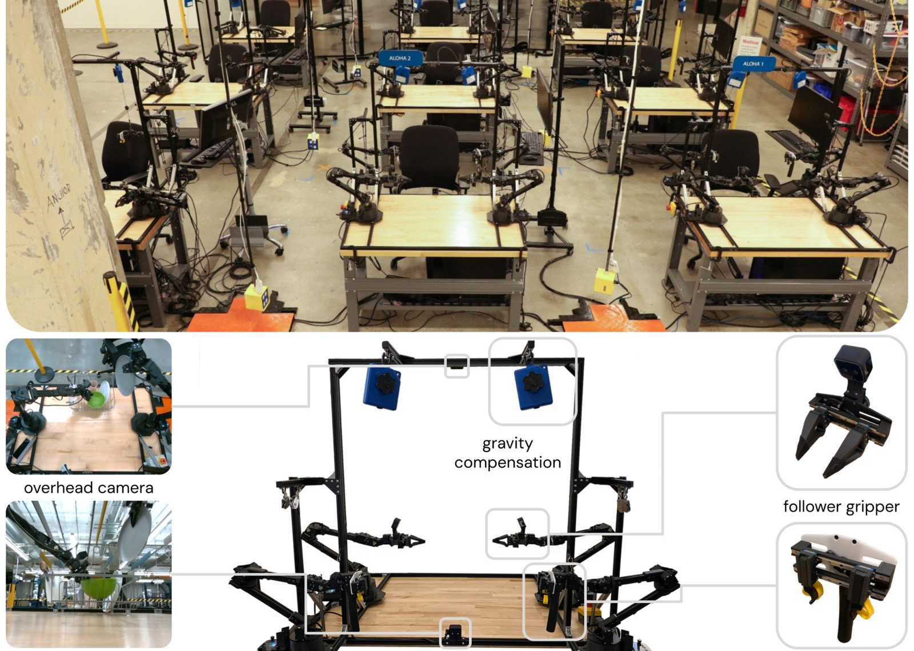
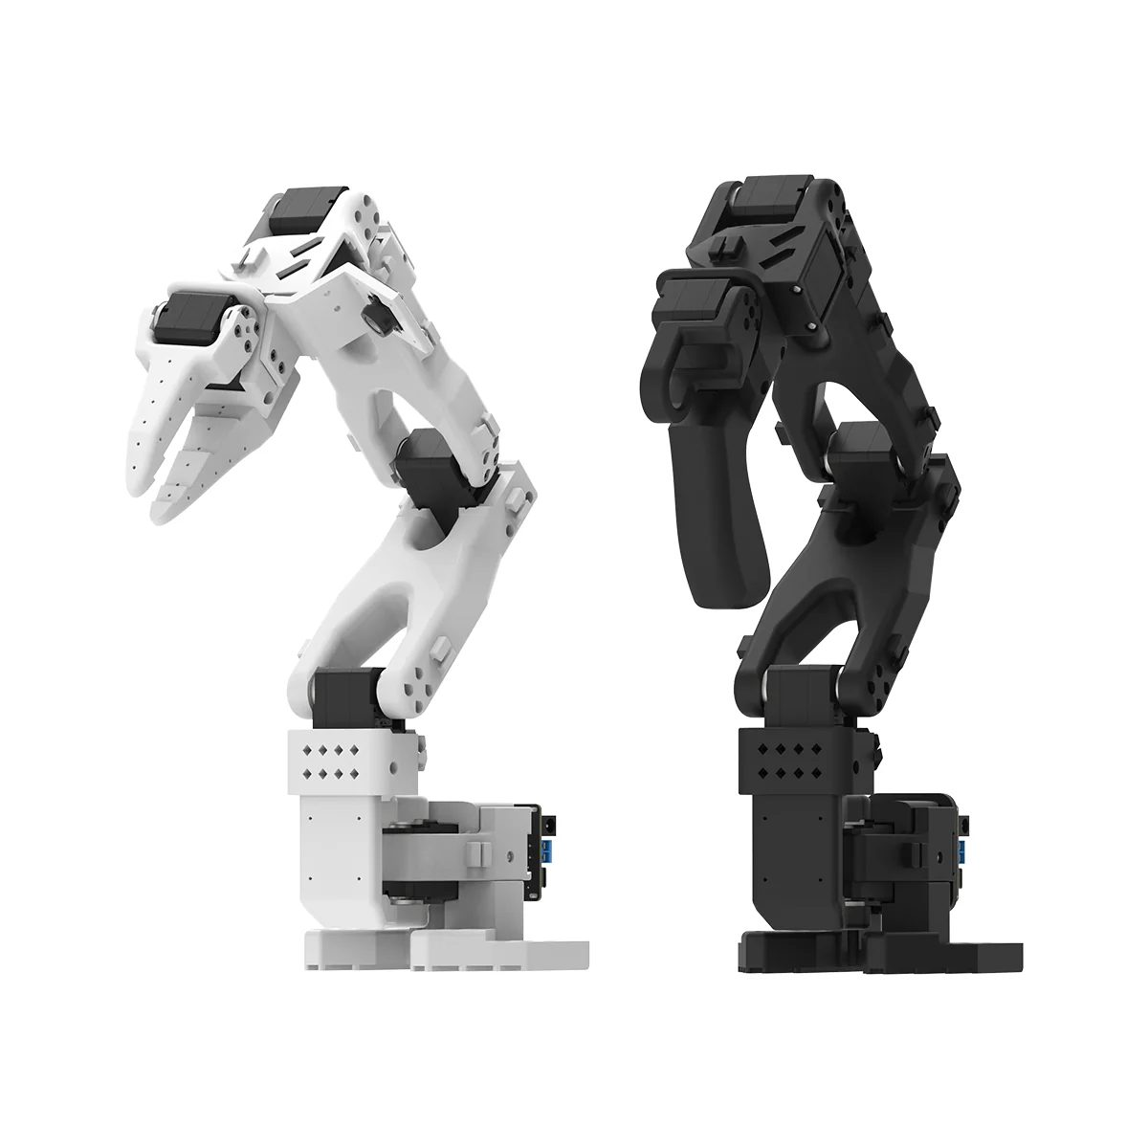
Why SO-ARM101
III.5.2 COMPARISON OF HARDWARE
 | Franka Panda | ALOHA | SO-ARM101
Type | Single research arm | Bimanual teleop | Low-cost leader-follower
DoF | 7 | 6 per arm | 5 + gripper
Strength | Precision, reliability | Fine-grained demos | Cost, open design
Limit | High cost | Complex, costlier | Payload, rigidity, precision
VISTA · Capstone Defense
Source: Report §III.5.2
Notes:
Purpose is a controlled affordable environment, not replacing research-grade arms.

Slide 31
Efficiency vs capability: newer VLAs are larger
III.6 GAP 1
Policy | Parameters | Published
S²-VLA | 2B | 2026-06-29
FabriVLA | 0.88B | 2026-07-10
V-JEPA Policy | 0.9B | 2026-09-29
SPAR | 1.12B | 2026-10-19
RynnVLA-Latent | 4B | 2026-10-25
PredVLA / MINERVA | ~0.68M / 0.54M | 2026-08-27 / 09-03
SmolVLA about 456M parameters stays lightweight. Evidence is missing on improving it without growing it.
VISTA · Capstone Defense
Source: Report §III.6, Table X
Notes:
Report table header says billions but lists two models in millions; units shown as in the model entries. Verify.

Slide 32
SmolVLM image pretraining is OCR-heavy
III.6 GAP 2
OCR and documents
48%
Captioning
14%
Charts
12%
Reasoning and logic
9%
Tables
9%
VQA
8%
Proposed direction: keep SmolVLA, swap in a lightweight backbone selected by size, benchmarks and integration fit, with an adapter to the action expert.
VISTA · Capstone Defense
Source: Report §III.6 [19]
Notes:
Static image mixture from the SmolVLM paper. Suggests a general multimodal model, not one tuned for spatial grounding.

Slide 33
Necessity and originality
III.7 JUSTIFICATION
Necessity
Originality
OpenVLA ~7B, π0 ~3.5B: hard on consumer GPUs (8 GB VRAM or less). Newer VLAs stay larger than SmolVLA.
Adapter mechanism for swapping backbones plus an evaluation framework for backbone selection.
Research question: can a carefully selected VLM backbone improve manipulation while preserving or improving SmolVLA’s efficiency?
VISTA · Capstone Defense
Source: Report §III.7
Notes:
Contribution: a systematic approach to backbone selection and integration, evaluated against SmolVLA and ACT on SO-ARM101.

Slide 34
Research question (section text TBD)
IV.1 RESEARCH QUESTIONS
TBD — section text to be finalized
Can a carefully selected alternative VLM backbone improve manipulation performance while preserving, or further improving, SmolVLA’s computational efficiency?
RQ1 [TBD]
RQ2 [TBD]
Hypotheses and numeric pass criteria are fixed in WBS 3.1.
Efficiency: parameters, memory, latency.
VISTA · Capstone Defense
Source: Report §I.4, §III.6, WBS 3.1
Notes:
Report IV.1 contains only a placeholder. The question shown is taken verbatim in meaning from Sections I.4 and III.6.

Slide 35
SO-ARM101: compact, open, low-cost
IV.2a HARDWARE SETUP
Structure
5 joints + gripper, PETG 3D-printed shell, Feetech servos
Reach and workspace
~300 mm reach; practical 100–280 mm from base
Payload and gripper
~300 g at max reach; opening 50–54 mm
VISTA · Capstone Defense
Source: Report §IV.2a
Notes:
Original mechanical design retained; servos adapted to locally available parts in Vietnam. Team generated its own 2D drawings from 3D models in FreeCAD.

Slide 36
Leader and follower are built for different jobs
IV.2a HARDWARE SETUP
 | Leader | Follower
Role | Human input device | Executes and runs policy
Gear ratio | 1:191, 1:345, 1:147 by joint | 1:345 on all 6 servos
Priority | Easy back-driving | Output torque
End-effector | Pistol grip + trigger | Movable-jaw gripper
Used in | Data collection only | Collection and evaluation
VISTA · Capstone Defense
Source: Report §IV.2a
Notes:
Leader joints 1,3 use 1:191, joint 2 uses 1:345, joints 4–6 use 1:147. Leader gives no force feedback to the demonstrator.

Slide 37
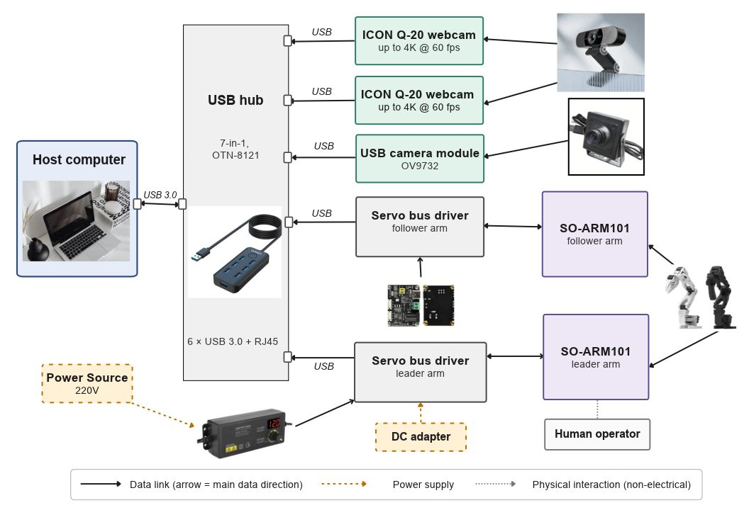
Hardware-to-computer connection
IV.2a HARDWARE SETUP
Power: 220 V → 60 W adapter → 2 bus drivers
Data: 7-in-1 USB hub → host PC
Cameras: 2 ICON Q-20 + 1 OV9732 720p
Servos: STS3215, 19 kg·cm at 7.4 V
VISTA · Capstone Defense
Source: Report §IV.2a
Notes:
Host reads leader joint angles through its bus driver and sends commands to the follower driver for teleoperation.

Slide 38
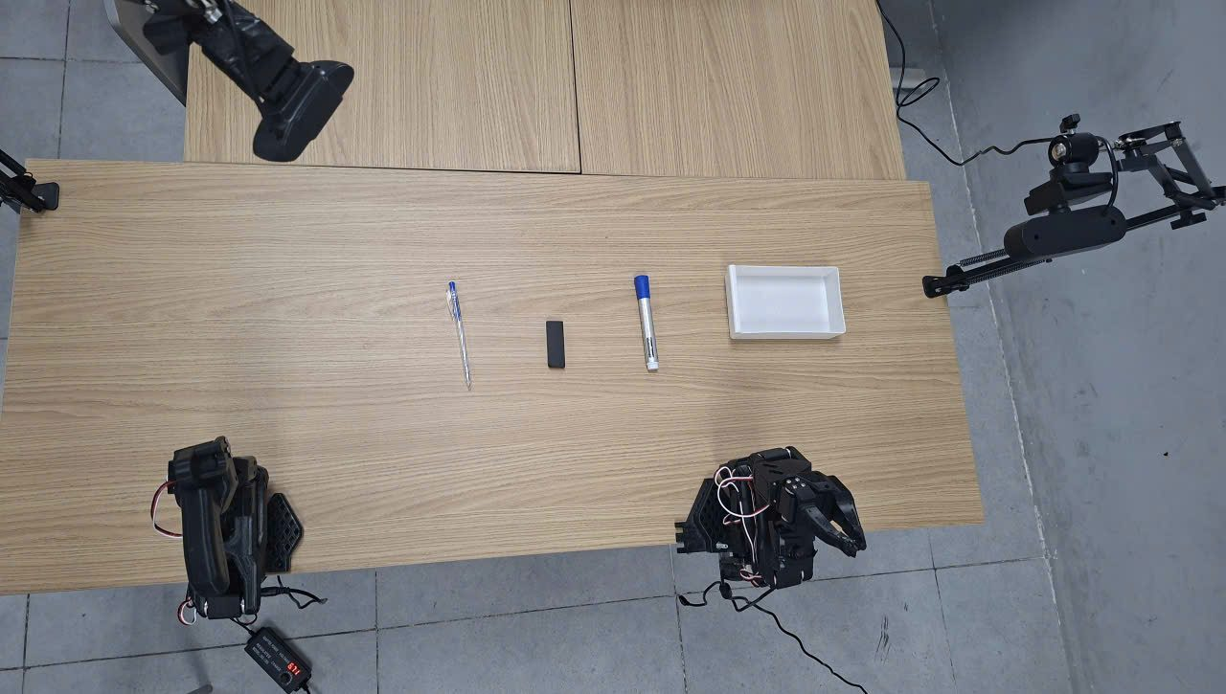
Pilot task: collect 3 items into a pencil case
IV.2b DESK STATIONERY DECLUTTERING
Goal
Identify, grasp and transfer all 3 items into the case
Variation
Item positions and orientations vary per trial
Why
Tests object distinction, grasp choice, narrow placement
VISTA · Capstone Defense
Source: Report §IV.2b
Notes:
Motivation: everyday desk organization; surveys on student cleanliness exist but are about living spaces generally. Related work: Rotrics DexArm, Tabletop HandyBot, CleanBot (SO-101 table clearing). This project uses the task as a controlled VLA test.

Slide 39
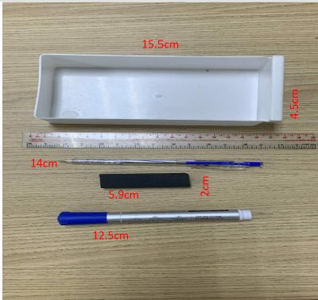
Four objects, all under 100 g
IV.2b DESK STATIONERY DECLUTTERING
Object | Size (cm)
Pencil case | 15.5 × 4.5 × 5
Ballpoint pen | 14 × 1
Brush pen | 12.5 × 2.5
Eraser | 6 × 2
VISTA · Capstone Defense
Source: Report §IV.2b
Notes:
Thin ballpoint pen is the hardest grasp; brush pen wider; eraser compact.

Slide 40
Five demonstration stages per item
IV.2b DESK STATIONERY DECLUTTERING
1
2
3
4
5
Target approach
Object grasping
Lift and transport
Placement positioning
Object release
Repeat for all three items. Prompt: “Pick the pens and rubber, put them into the whitebox.”
VISTA · Capstone Defense
Source: Report §IV.2b
Notes:
Operator uses the leader trigger to open and close the follower gripper.

Slide 41
Secondary task setup
IV.2c HALOGEN LAMPSHADE TRAY PACKAGING
TBD — to be updated after experiments
[Objects and dimensions]
[Layout and environment]
[Manipulation stages]
[Partner factory context]
VISTA · Capstone Defense
Source: Report §IV.2c
Notes:
Report section is only a heading. Task name is not final: Section II.2.6 mentions a change to sorting and arranging lighting-related items after a lifting limitation.

Slide 42
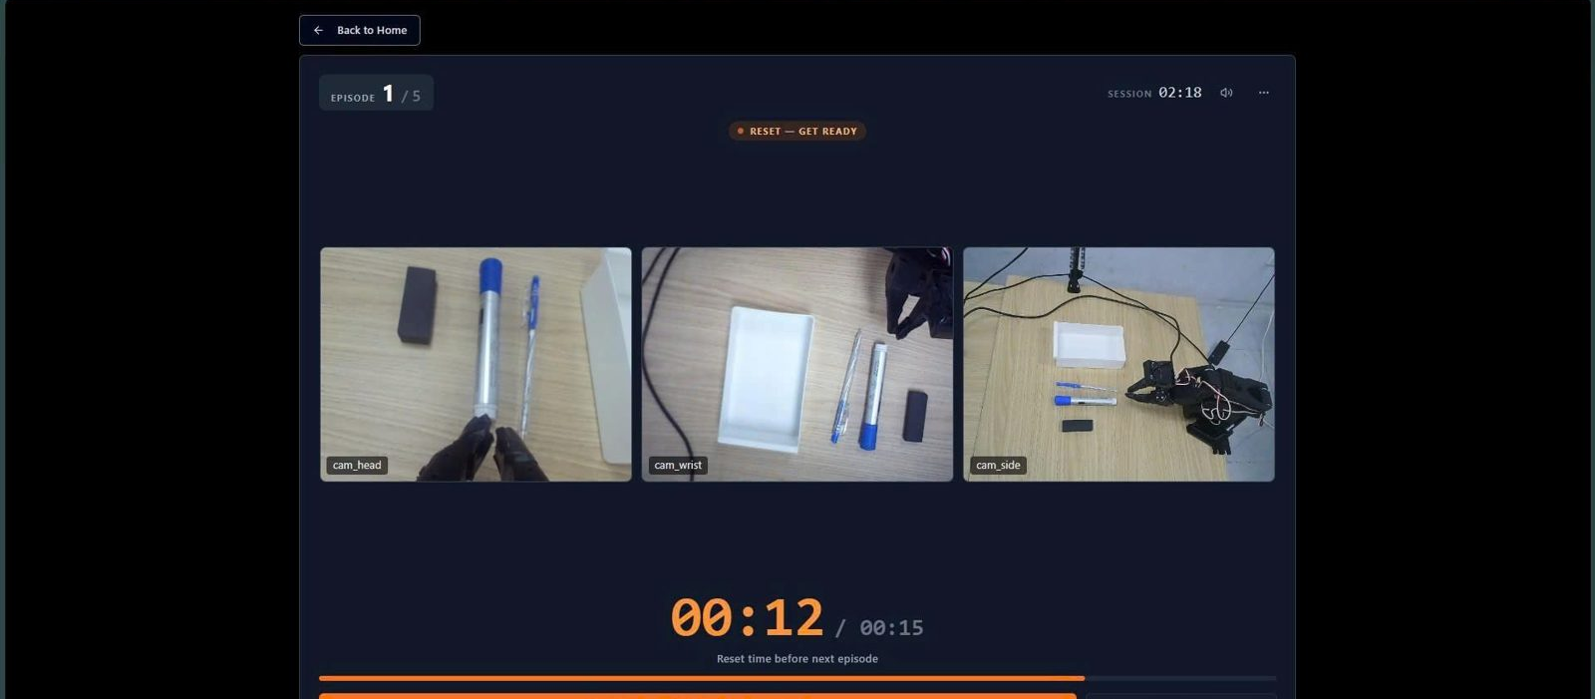
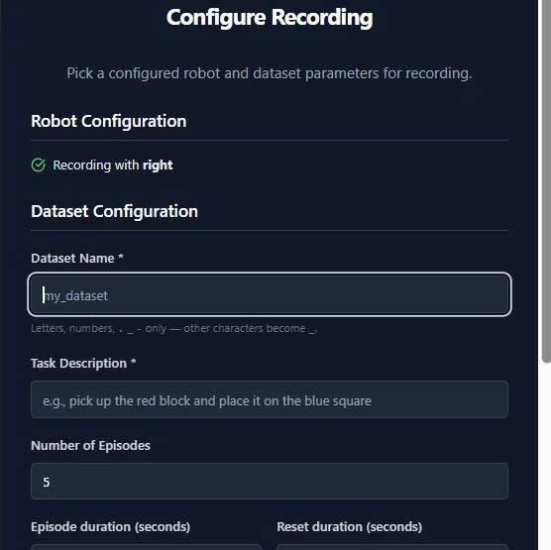
Why we collect our own real-world data
IV.3 DATA COLLECTION
No simulation
No public fit
LeLab
Avoids sim-to-real gap; all data is real.
Open datasets are not on SO-ARM101; objects and 3 cameras differ.
Web UI for calibrate, teleoperate, record, train, replay.
VISTA · Capstone Defense
Source: Report §IV.3a
Notes:
Two datasets: Pick-and-Place and Long Horizon naming used in the report.

Slide 43
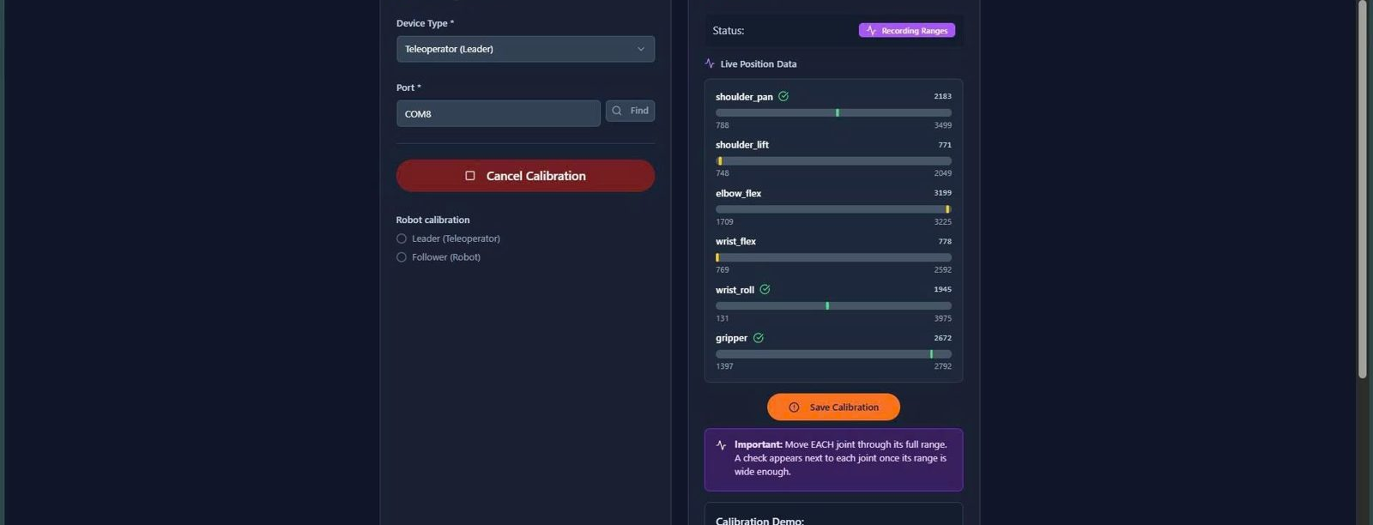
From calibration to recording
IV.3 COLLECTION METHOD
1
2
3
4
5
Find port
Calibrate joint ranges
Add 3 cameras: head, wrist, side
Set dataset name, prompt, episodes, durations
Teleoperate and record
Calibration file saved per arm. Task prompt becomes the VLA language instruction.
VISTA · Capstone Defense
Source: Report §IV.3a
Notes:
Follower will not match leader perfectly because of calibration differences.

Slide 44
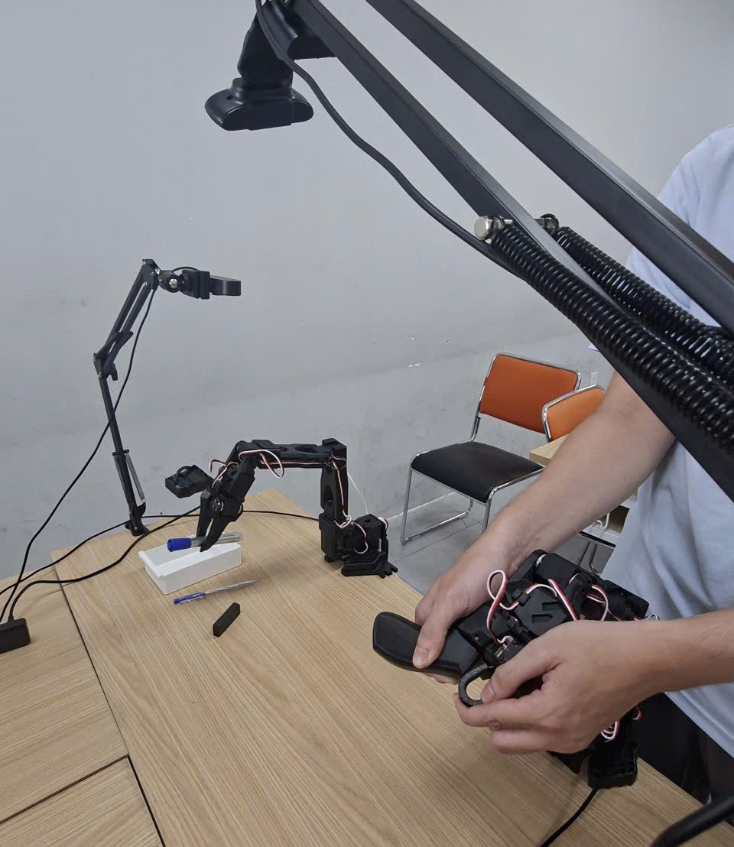
300 episodes per task, two operators
IV.3 DATA PROTOCOL
Target
300 episodes per task; 120 s per episode (Desk task)
Operators
One runs LeLab, one teleoperates; swap about every 50 demos
Schedule
About 1 day collecting + 1 day cleaning per dataset
Preprocessing
Remove failed or corrupt episodes, split by episode, compute statistics
VISTA · Capstone Defense
Source: Report §IV.3, WBS 4.6
Notes:
Halogen dataset details (selection criteria, sample information) are TBD in the report. Reset duration value “15,000” lacks a unit in the report.

Slide 45
Model inputs and features
IV.4 FEATURE SELECTION AND ENGINEERING
TBD — to be updated after experiments
[Camera views]
[Robot state]
[Task prompt]
VISTA · Capstone Defense
Source: Report (placeholder)
Notes:
Report section is only a placeholder. Slots show what the dataset records (3 cameras, state, prompt); selection rationale is TBD.

Slide 46
Backbone replacement framework
IV.5 METHOD
TBD — to be updated after experiments
[Backbone selection criteria]
[Adapter: token and feature dimensions]
[Layer selection per backbone]
[Action-expert connection]
SmolVLM-2
→ swap →
LFM2.5-VL-0.45B
FastVLM-0.5B
VISTA · Capstone Defense
Source: Report (placeholder)
Notes:
Report heading only. Slots mirror the four challenges in Section I.4. Candidates: LFM2.5-VL-0.45B and FastVLM-0.5B.

Slide 47
Four configurations, identical data and settings
IV.6 MODEL TRAINING AND VALIDATION
TBD — to be updated after experiments
Model | Steps | Batch | LR | Seeds
ACT baseline | [TBD] | [TBD] | [TBD] | [TBD]
SmolVLA original | [TBD] | [TBD] | [TBD] | [TBD]
SmolVLA + LFM2.5-VL | [TBD] | [TBD] | [TBD] | [TBD]
SmolVLA + FastVLM | [TBD] | [TBD] | [TBD] | [TBD]
Planned: Kaggle GPU, frozen dataset v1.0, episode-level split, offline validation on held-out episodes.
VISTA · Capstone Defense
Source: Report §IV.6, WBS 6
Notes:
Hyperparameters are justified from papers or calculations (WBS 6.1).

Slide 48
Performance and efficiency metrics
IV.7 EVALUATION METRICS
TBD — formulas and thresholds
Performance
Efficiency
Statistics
Task success rate · progress score
Latency median and p95 · memory · parameter count
Confidence intervals and tests [TBD]
VISTA · Capstone Defense
Source: WBS 3.2, §II.2.6
Notes:
Metrics are named in WBS 3.2 and Section II.2.6. Section IV.7 itself is a placeholder.

Slide 49
Tools and pipeline
IV.8 IMPLEMENTATION PLAN
TBD — to be updated after experiments
[LeRobot + SO-ARM101]
[Kaggle training, GitHub archive]
[Control and monitoring app]
VISTA · Capstone Defense
Source: Report (placeholder)
Notes:
Report heading only. Tools named elsewhere: LeRobot, Kaggle, GitHub, Google Drive, ClickUp, Discord.

Slide 50
Ethics and safety considerations
IV.9 ETHICAL AND SAFETY
TBD — to be updated after experiments
[Data privacy]
[Robot safety (e-stop, joint limits)]
[Factory site rules and video permission]
VISTA · Capstone Defense
Source: Report (placeholder)
Notes:
Report placeholder. WBS 9.1 plans a safety checklist: emergency stop, joint limits, workspace, site access, recording permission.

Slide 51
Model and system interfaces
V.1 AI MODEL INTEGRATION
TBD — to be updated after experiments
[Policy ↔ robot interface]
[Policy switching]
[Camera and 3D pose]
VISTA · Capstone Defense
Source: Report (placeholder)
Notes:
Placeholder in report.

Slide 52
From collection to results
V.2 DATA FLOW AND PROCESSING
TBD — to be updated after experiments
[Collect]
[Process]
[Train]
[Evaluate]
VISTA · Capstone Defense
Source: Report (placeholder)
Notes:
Placeholder in report.

Slide 53
Deployment environment and procedure
V.3 DEPLOYMENT STRATEGY
TBD — to be updated after experiments
[Environment]
[Procedure]
[Factory demo]
VISTA · Capstone Defense
Source: Report (placeholder)
Notes:
Placeholder in report.

Slide 54
Growth and versioning
V.4 SCALABILITY AND MAINTENANCE
TBD — to be updated after experiments
[Add new backbones]
[Version management]
[Maintenance]
VISTA · Capstone Defense
Source: Report (placeholder)
Notes:
Placeholder in report.

Slide 55
Results table (to be filled)
VI.1 RESULTS AND ANALYSIS
TBD — to be updated after experiments
Model | Success A | Success B | Latency (med/p95) | Memory | Params
ACT | [TBD] | [TBD] | [TBD] | [TBD] | [TBD]
SmolVLA | [TBD] | [TBD] | [TBD] | [TBD] | [TBD]
+ LFM2.5-VL | [TBD] | [TBD] | [TBD] | [TBD] | [TBD]
+ FastVLM | [TBD] | [TBD] | [TBD] | [TBD] | [TBD]
[Chart: success rate with confidence intervals · failure taxonomy]
VISTA · Capstone Defense
Source: Report §VI.1, WBS 7
Notes:
No results exist in the report yet. Do not present numbers until trials finish.

Slide 56
Answering the research question
VI.2 DISCUSSION
TBD — to be updated after experiments
[Verdict per objective O1–O6]
[Alignment with related work]
[Limitations and threats]
VISTA · Capstone Defense
Source: Report (placeholder)
Notes:
Placeholder.

Slide 57
Next steps
VI.3 RECOMMENDATIONS
TBD — to be updated after experiments
[Research]
[System improvements]
[Practical use]
VISTA · Capstone Defense
Source: Report (placeholder)
Notes:
Placeholder.

Slide 58
Lessons learned
VI.4 PERSONAL REFLECTION
TBD — to be updated after experiments
[What worked]
[What to improve]
[Team learning]
VISTA · Capstone Defense
Source: Report (placeholder)
Notes:
Optional section; placeholder. Section II.2.6 defines lesson categories: integration, data, training, management, teamwork, safety.

Slide 59
Main findings
VII.1 SUMMARY OF FINDINGS
TBD — to be updated after experiments
[Answer to research question]
[Goals achieved]
VISTA · Capstone Defense
Source: Report (placeholder)
Notes:
Placeholder.

Slide 60
Contributions
VII.2 CONTRIBUTIONS AND REFLECTIONS
TBD — to be updated after experiments
[Technical]
[Community]
[Industry]
VISTA · Capstone Defense
Source: Report (placeholder)
Notes:
Placeholder. Planned contributions from Section I.5: swap framework, evidence on backbone choice, low-cost factory feasibility.

Slide 61
Limits and directions
VII.3 LIMITATIONS AND FUTURE WORK
TBD — to be updated after experiments
[Limitations]
[Future work]
VISTA · Capstone Defense
Source: Report (placeholder)
Notes:
Known limitations are in Section I.6 (candidate set, data, single robot, compute, fast-changing field).

Slide 62
Thank you — questions?
Q&A
Question
Platform
Does a better lightweight backbone help SmolVLA?
SO-ARM101 · LeRobot · LFM2.5-VL · FastVLM
VISTA · Capstone Defense
Source: —
Notes:
Close. Invite questions from committee.

